Slide 1
Classification, Reserve & RQO determination of water resources in the Mvoti to Umzimkulu Water Management Area
ESTUARY CONSEQUENCES
Lara van Niekerk
CSIR
16 Sept 2015
PRESENTATION TITLE
Presented by:
Name Surname
Directorate
Date

Slide 2
Overall conclusions
Water quality a major pressure on this coast
Most systems along this coastline small to very small.
No assimilative capacity: Responsive to WW input
Plants: Increase submerged macrophytes, microalgal blooms and reed growth in response to more nutrients.
Invertebrates and fish: Respond to the system’s eutrophic conditions and Low O₂ in low flow periods.
Birds: Loss of invertebrate and fish prey & loss of foraging habitat trough encroachment.
 HIGH RISK FOR FISH KILLS: At incised or deeper estuaries, with limited opportunity for wind mixing. Die-off of vegetation will cause high detrital loads, with detrital input reducing the oxygen levels causing possible fish kills.

Slide 3
Overall summary
Northern Cluster
Ilembe
Central Cluster
eThekwini
Southern Cluster
Ugu
64 systems
Overall 12% (8 systems) in poor condition (< D/E)
High conservation requirements = 23 systems
2 poor condition sections
Grey bars: Existing WWW

Slide 4
NORTHERN CLUSTER ECOLOGY CONSEQUENCES
4 system of conservation importance that need improvement : Mhlali, Mvoti, Mdlotane, Zinkwasi
Nonoti: most scenarios maintain PES. While ScA1 shows an improvement in condition and worst case (Sc2) shows a decline.
Mvoti: most scenarios maintain PES, require other intervention to attain REC. WW scenarios reduce PES.
Mlali: most scenarios result in declining health due to nutrient loading. Only improve under Sc1 if WW removed.

Nonoti

Mvoti

Mhlali
D C B A
Notes:
Known fish kill: Mhali

Slide 5
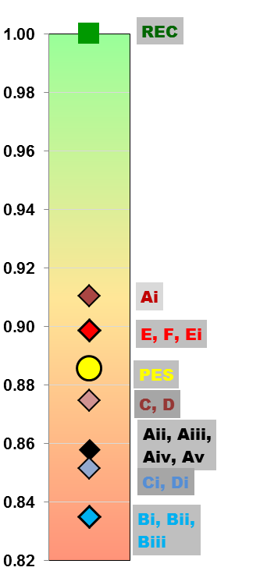
NORTHERN CLUSTER ECOLOGY CONSEQUENCES
None of the scenarios meet the REC, but
Ai, E, F, Ei is an improvement of the PES as they represent a reduction in Present day WW to these systems.
Still require other interventions – restore riparian area, improve catchment WQ
C and D some decline in health
All these scenarios lie below the PES due to reduced WQ & related O₂ stress
Sc B are the worst case scenarios that far exceed assimilative capacity, high risk of fish kills

Slide 6
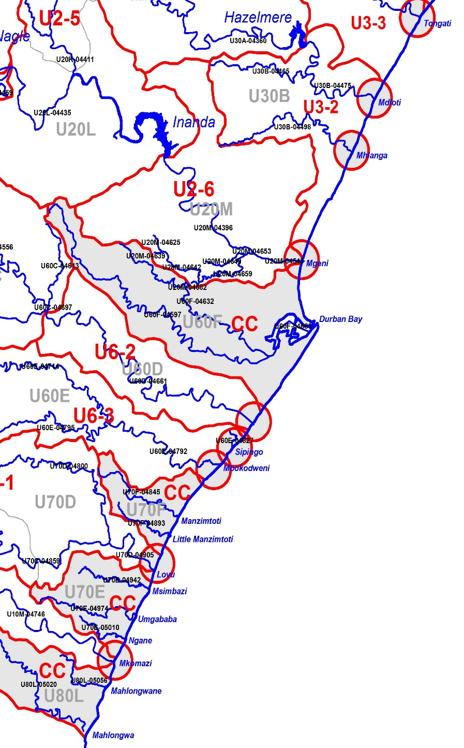
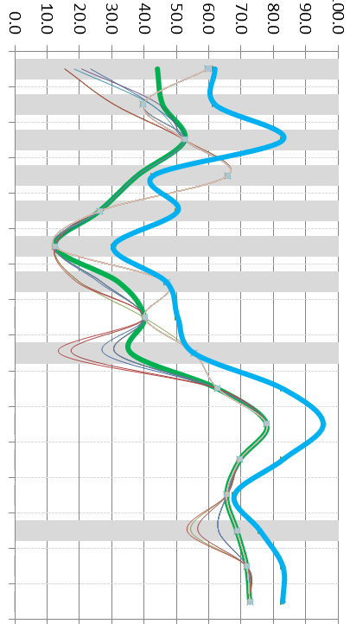

CENTRAL CLUSTER ECOLOGY CONSEQUENCES


Tongati
9 system of conservation importance: Mahlongwa, Mahlongwane, Mkomazi, Umgababa, Msimbazi, Lovu,Durban Bay, Mgeni, Mhlanga
5 systems in poor condition (< E/D)
Tongati: Most scenarios show severe decline in health due to nutrient loading. Only improve under Sc1 if WW removed. Some sensitivity to level of treatment
Mdloti: Most scenarios show a decline in health due to nutrient loading. Do NOT improve under Sc1 if WW removed as catchment quality is very poor. More closed = poor O₂. Relative insensitive to level of treatment.
Mdloti
Umhlanga

uMngeni

Durban Bay
Sipingo
Mbokodweni


Little Amanz


uMkhomazi
F E D C B A
Notes:
Known fish kills: Amazintoti (Aug 2015), Isipingo (July 2014)

Slide 7

CENTRAL CLUSTER ECOLOGY CONSEQUENCES


Tongati
uMgeni: Potential improvement in condition as a result of higher inflows. (under investigation).
Mbokodweni: Declining health under most scenarios due to nutrient loading, But maintain PES under Sc2. Improve significantly under Sc1 if WW removed. Relative insensitive to treatment
Little Amanzintoti: Most scenarios show a severe decline in health, but will maintain E under 8 Ml/d. Improve significantly if WW removed. Relative insensitive to treatment
Umkomazi: High Importance. All flow scenario maintain PES, require other intervention to attain REC. Most WW scenarios degrade condition. MK1 (5 ML/d) on average maintain PES, but high risk of fish kills when closed.
Mdloti
Umhlanga

uMngeni

Durban Bay
Sipingo
Mbokodweni
At Mlali there is a similar trend but there is more differentiation between scenarios due to different water quality impact and consequences…………………….


Little Amanz


uMkhomazi
F E D C B A

Slide 8
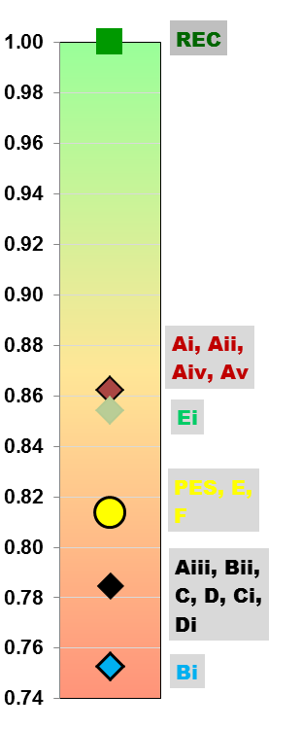
CENTRAL CLUSTER CONSEQUENCES
None of the scenarios meet the REC, but
Ai, Aii, AiV and Av, as well as Ei is a significant improvement of the PES as they represent a reduction in Present day WW to these systems.
Still require other interventions – restore riparian area, improve catchment WQ
E & F Maintain the PES
All these scenarios lie below the PES due to reduce WQ, O₂ stress, high risk of fish kills
Bii are the worst case scenario that far exceed assimilative capacity, very high risk of fish kills

Slide 9
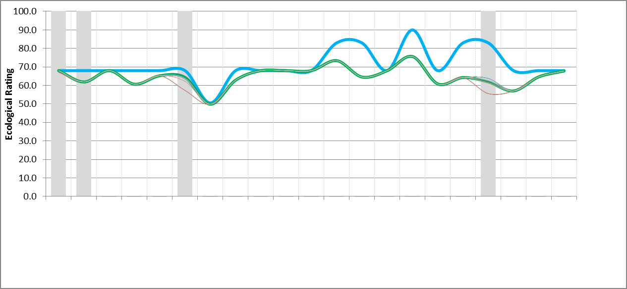
SOUTHERN CLUSTER CONSEQUENCES
Mpambanyoni

Mzimayi
10 system of conservation importance: Mtamvuna, Mpenjati, Zotsha, Mzimkulu, Damba, Koshwana, Intshambili, Mhlabatshane, Mfazazana, Kwa-Makosi
Mpambanyoni: All scenario maintain the PES, slight decline in Worst case (Sc 2).
Mzimayi: Maintain Status Quo
Sezela: Most scenarios maintain current condition. While ScA1 shows an improvement in condition and Worst case (D4, Sc2) shows a decline.
Koshwana: Most scenarios maintain PES. While ScA1 shows an improvement and worst case (Sc2) shows a significant decline.

Sezela


Koshwana
D C B A

Slide 10
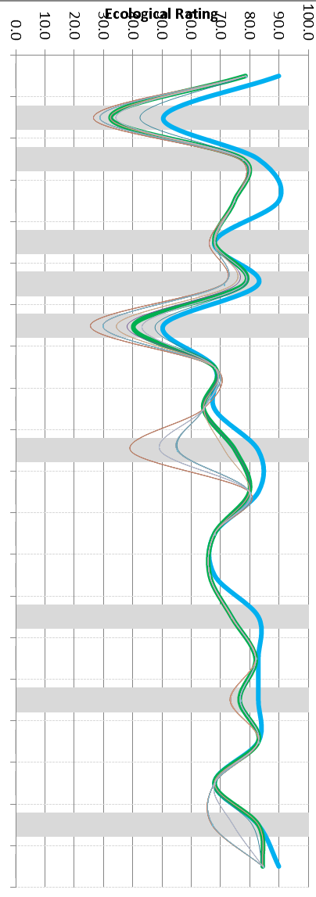
SOUTHERN CLUSTER CONSEQUENCES
Mbango
Mbango: Most scenarios maintain PES = E. Under ScA1 a significant improvement in condition. Worst case (A1a, Sc2) shows a further decline.
Boboyi & Mhlangeni: Most scenario maintain the PES, with a decline under Worst case (Sc 2).
Vungu: Decline under future scenarios
Kongweni: Most scenarios show a decline in health (PES = D/E). Improve if WW is removed.
Mvutshi: Most scenarios show a significant decline in health (PES = B).
Mpenjati: Scenarios maintain PES
Tongazi & Zolwane: Half the scenarios indicate a (significant) decline condition, while half maintain or improve the PES.
Boboyi
Mhlangeni

Vungu
Kongweni
Mvutshini

Mpenjati
Tongazi

Zolwane
D C B A

Slide 11
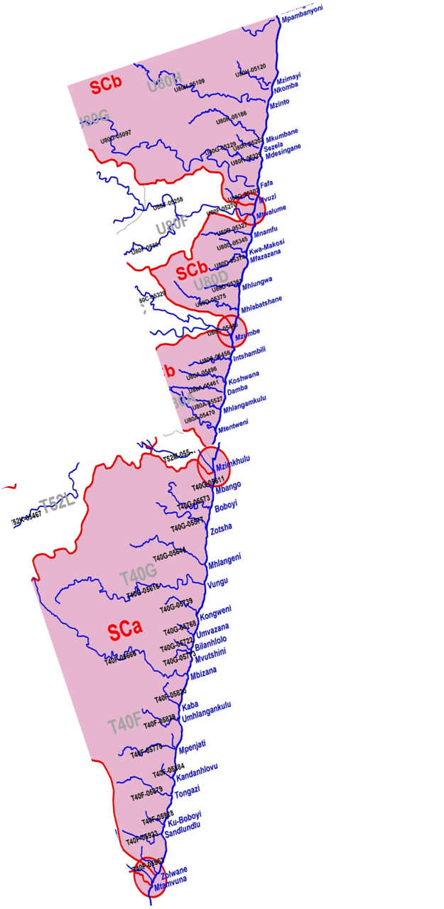
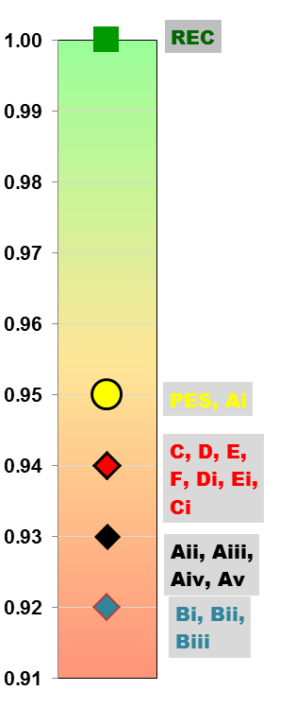
SOUTHERN CLUSTER CONSEQUENCES
None of the Scenarios meet the REC or even improve the PES.
Ai maintain the PES
All other scenarios decrease the PES.
Aii - v & Bi-iii are the worst case scenario that far exceed assimilative capacity, very high risk of fish kills

Slide 12
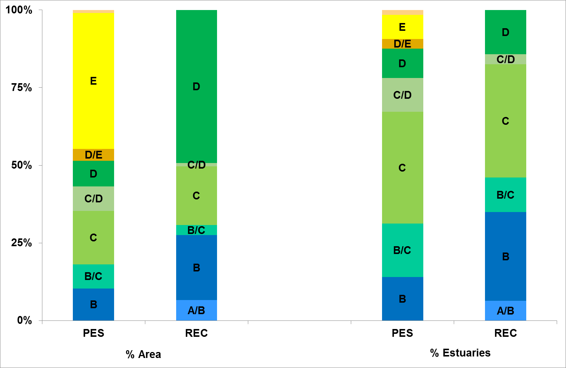
Summary of PES vs REC
PES: Only 10% of area (14) in A or B Category
REC: strives to achieve conservation & living resource management targets = 28% (36 systems)

Slide 13
Way forward
What was presented was the ecological perspective.
It has a focus on protecting estuary ecological infrastructure, meeting biodiversity targets and enhancing ecosystem services such a fish nursery areas and fishing.
This now goes to the MCA model to evaluate against impact on ecosystem services, jobs and economics of the region.
Regulators then to decide on the ultimate configuration, i.e. how many of the ecological targets can be met.

Slide 14
PRESENTATION TITLE
Presented by:
Name Surname
Directorate
Date
THANK yOU

